Slide 1



01AI0506 - Design and Analysis of Algorithm
Unit – 6
NP-Complete and Approximation Algorithm
Prepared by
Prof. Abhishek Chauhan
CSE- AI, ML & DS Department

Slide 2



Tractable and Intractable Problems
In computational theory and problem-solving, tractable and intractable problems describe the ease or difficulty of finding a solution using algorithms.
Understanding this distinction is crucial in computer science, especially in areas like algorithm design, artificial intelligence, and optimization.
Tractable Problems
Tractable problems are those for which an algorithm can solve the problem efficiently, typically within polynomial time.
Definition: Problems that can be solved in a reasonable amount of time (e.g., linear, quadratic, cubic time complexity).

Slide 3
Tractable and Intractable Problems
Examples:
    Sorting algorithms - merge sort, quick sort
    Searching algorithms - binary search
    Shortest path algorithms - Dijkstra's algorithm
Real-World Example:
    Scheduling meetings or finding the shortest driving route between two cities on a map are considered tractable problems.

Slide 4
Tractable and Intractable Problems
Intractable Problems
Intractable problems are those for which no efficient algorithm is known to solve them within polynomial time.
The time required grows exponentially or factorially with the size of the input, making them impractical to solve for large inputs.
Definition: Problems that cannot be solved efficiently or are computationally expensive.

Slide 5
Tractable and Intractable Problems
Examples:
    The Traveling Salesman Problem
    Graph coloring problems
Real-World Example:
    Determining the optimal routes for a fleet of delivery trucks when the number of locations is very large (TSP).

Slide 6
Polynomial Time Algorithms
Polynomial time algorithms are fundamental in computational theory and computer science.
These algorithms solve problems in a time that can be expressed as a polynomial function of the size of the input, making them efficient and practical for many applications.
Definition
A polynomial time algorithm is one whose running time is bounded by a polynomial expression in the size of the input (denoted as 𝑛).

Slide 7
Polynomial Time Algorithms
What Is Polynomial Time?
If the running time T(n) of an algorithm is proportional to a polynomial expression of the input size n, such as:
T(n) = O(𝑛^{𝑘})
where 𝑘 is a constant, the algorithm operates in polynomial time.
Examples of Polynomial Time Complexities
    O(n) (Linear time)
    O(n²)(Quadratic time)
    O(n³)(Cubic time)
Why Polynomial Time?
Feasibility: Problems solvable in polynomial time are deemed computationally feasible.

Slide 8
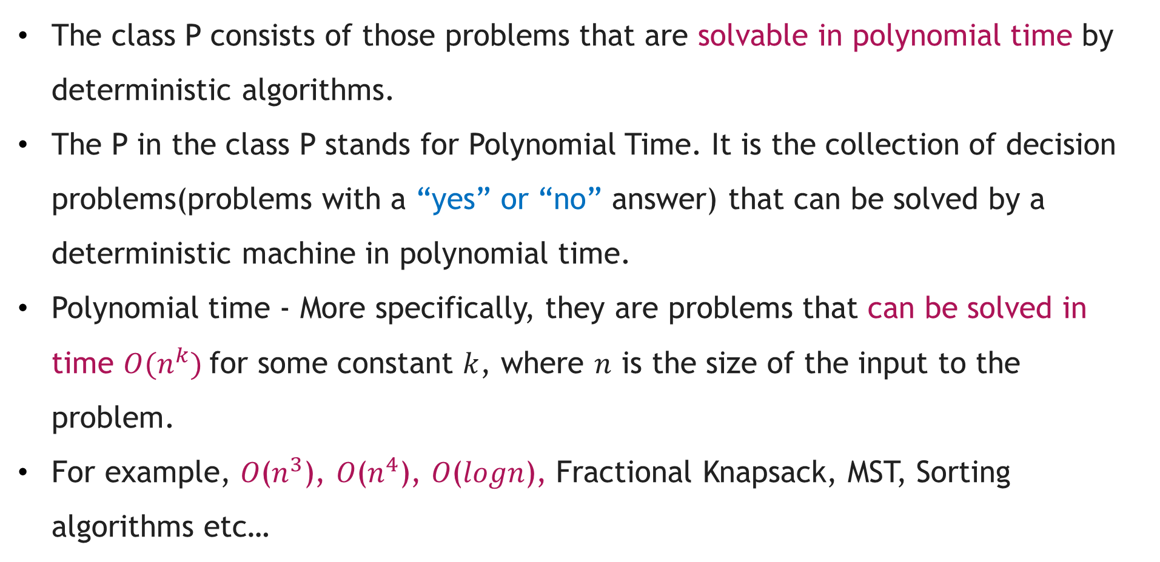
The Class P
The class P consists of those problems that are solvable in polynomial time by deterministic algorithms.
The P in the class P stands for Polynomial Time. It is the collection of decision problems(problems with a “yes” or “no” answer) that can be solved by a deterministic machine in polynomial time.
Polynomial time - More specifically, they are problems that can be solved in time $O(n^{k})$for some constant $k$, where $n$ is the size of the input to the problem.
For example, 𝑂($n^{3}$), 𝑂($n^{4}$), 𝑂(𝑙𝑜𝑔𝑛), Fractional Knapsack, MST, Sorting algorithms etc…

Slide 9
The Class P
Features:
The solution to P problems is easy to find.
P is often a class of computational problems that are solvable and tractable. Tractable means that the problems can be solved in theory as well as in practice. But the problems that can be solved in theory but not in practice are known as intractable.
Examples:
    Calculating the greatest common divisor
    Finding a maximum matching
    Merge Sort

Slide 10
The NP class
NP is Non-Deterministic polynomial time.
The class NP consists of those problems that are verifiable in polynomial time.
NP is the class of decision problems for which it is easy to check the correctness of a claimed answer, with the help of a little extra information.
Hence, we are not asking for a way to find a solution, but only to verify that an alleged solution really is correct.
Every problem in this class can be solved in exponential time using exhaustive search.

Slide 11
The NP class
Features
The solutions of the NP class are hard to find since they are being solved by a non-deterministic machine but the solutions are easy to verify.
Problems of NP can be verified by a Turing machine in polynomial time.
Example
    Boolean Satisfiability Problem (SAT)
    Hamiltonian Path Problem
    Graph coloring

Slide 12
Classification of NP Problems
NP Hard
An NP-hard problem is at least as hard as the hardest problem in NP and it is a class of problems such that every problem in NP reduces to NP-hard.
Features:
  All NP-hard problems are not in NP.
  It takes a long time to check them. This means if a solution for an NP-hard problem is given then it takes a long time to check whether it is right or not.
  A problem A is in NP-hard if, for every problem L in NP, there exists a polynomial-time reduction from L to A.

Slide 13
Classification of NP Problems
Examples of problems in NP-Hard
    Halting problem
    Qualified Boolean formulas
    No Hamiltonian cycle
2. NP Complete
A problem is NP-complete if it is both NP and NP-hard. NP-complete problems are the hard problems in NP.

Slide 14
Classification of NP Problems
Features:
NP-complete problems are special as any problem in NP class can be transformed or reduced into NP-complete problems in polynomial time.
If one could solve an NP-complete problem in polynomial time, then one could also solve any NP problem in polynomial time.
Example problems:
  Hamiltonian Cycle
  Satisfiability
  Vertex cover

Slide 15
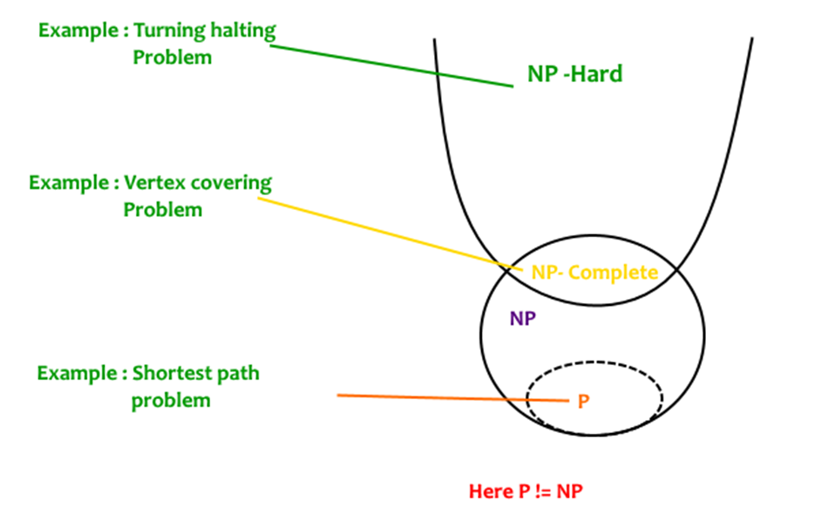
P, NP Hard and NP Complete

Slide 16
Venn Diagram Representation
Venn Diagram
A Venn diagram is a graphical representation of mathematical or logical relationships between different sets.
Use of Venn Diagram
Venn diagram is used in mathematics to understand the set theory.
We also use it to understand the relationship between or among sets of objects. It depicts the set of intersections and unions.
Venn Diagrams are used to represent the groups of data in circles.

Slide 17
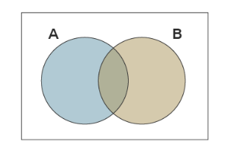
Venn Diagram Representation
Advantages of Venn Diagram
  It is used for both comparison and classification
  It groups the information into different parts
  It also highlights the similarities and differences
  Example

Slide 18
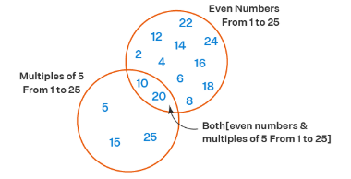
Venn Diagram Representation
Venn Diagram Example
Let us observe a Venn diagram example. Here is the Venn diagram that shows the correlation between the following set of numbers.
One set contains even numbers from 1 to 25 and the other set contains the numbers in the 5x table from 1 to 25.
The intersecting part shows that 10 and 20 are both even numbers and also multiples of 5 between 1 to 25.

Slide 19
Venn Diagram Representation
Terms for represents the Venn Diagram
Let us understand the following terms and concepts related to Venn Diagram, to understand it better.
Universal Set
Whenever we use a set, it is easier to first consider a larger set called a universal set that contains all of the elements in all of the sets that are being considered. Follow the below,
    A large rectangle is used to represent the universal set and it is usually denoted by the symbol E or sometimes U.

Slide 20
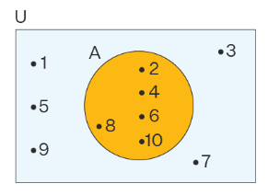
Venn Diagram Representation
    All the other sets are represented by circles or closed figures within this larger rectangle.
    Every set is the subset of the universal set U.

Slide 21
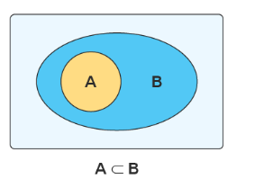
Venn Diagram Representation
    Subset
    Venn diagrams are used to show subsets. A subset is actually a set that is contained within another set.
    Let us consider the examples of two sets A and B in the below-given figure. Here, A is a subset of B. Circle A is contained entirely within circle B. Also, all the elements of A are elements of set B.

Slide 22
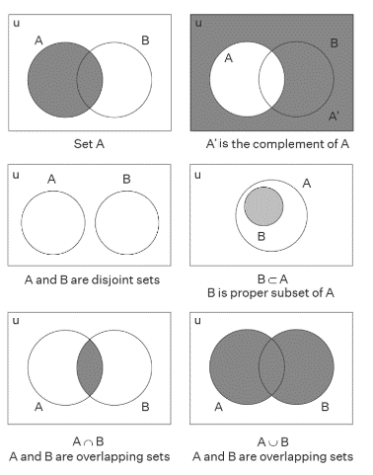
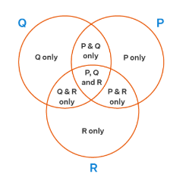
Venn Diagram Representation

Slide 23
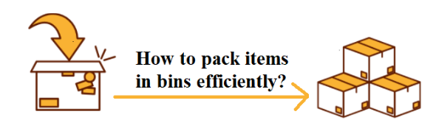
Bin Packing problem
Bin Packing problem involves assigning n items of different weights and bins each of capacity C to a bin such that number of total used bins is minimized. It may be assumed that all items have weights smaller than bin capacity.

Slide 24
Bin Packing problem
Mathematical Formulation of Bin Packing
The Bin-Packing Problem (BPP) can also be described,using the terminology of knapsack problems, as follows.
Given n items and n knapsacks (or bins), with
    Wj = weight of item j,
    cj = capacity of each bin
      assign each item to one bin so that the total weight of the items in each bin does not exceed c and the number of bins used is a minimum.

Slide 25
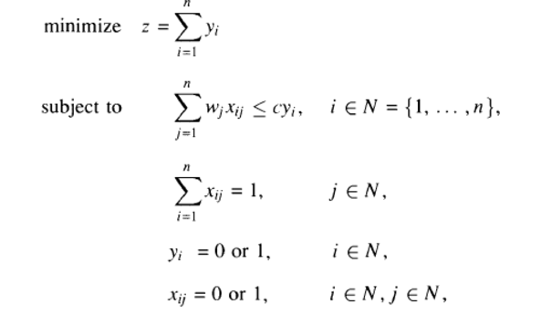
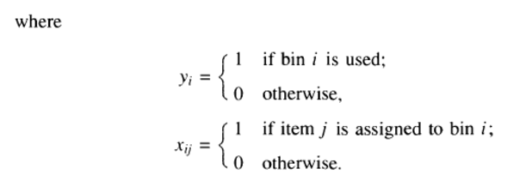
Bin Packing problem
A possible mathematical formulation of the problem is

Slide 26
Bin Packing problem
We will suppose, as is usual, that the weights Wj are positive integers. Hence, without loss of generality, we will also assume that c is a positive integer
    Wj < c for j belonging to N.
As you can see, we have a broad rule of approximation and not an exact algorithm. Such algorithms are called NP problems. In fact Bin Packing Problem is a NP-hard problem.

Slide 27
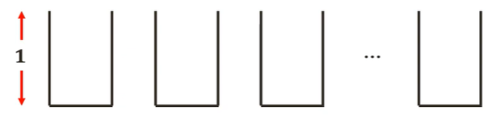
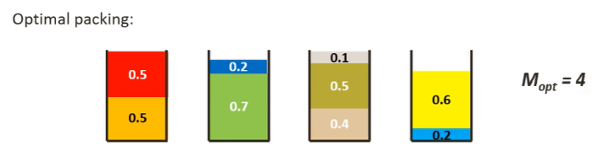
Bin Packing problem
For the Bin-Packing problem, let us consider bins of size 1,
Assuming the sizes of the items be {0.5, 0.7, 0.5, 0.2, 0.4, 0.2, 0.5, 0.1, 0.6}.

Slide 28
Bin Packing problem
For the Bin-Packing problem, let us consider bins of size 1,
Assuming the sizes of the items be {0.5, 0.7, 0.5, 0.2, 0.4, 0.2, 0.5, 0.1, 0.6}.

Slide 29
Bin Packing problem
Lower Bound on Bins
We can always find a lower bound on minimum number of bins required. The lower bound can be given as :
Min no. of bins >= Ceil ((Total Weight) / (Bin Capacity))
Different Algorithms:
Let us now look at the various optimization algorithms for Bin Packing Problem. Here we are going to discuss about Input Order dependent or Online Algorithms.
Under that we are going to see the following 4 algorithms depend on the order of their inputs. They pack the item given first and then move on to the next input or next item

Slide 30
Bin Packing problem
They pack the item given first and then move on to the next input or next item. The following algorithms are
1) Next Fit algorithm
2) First Fit algorithm
3) Best Fit Algorithm
4) Worst Fit Algorithm

Slide 31
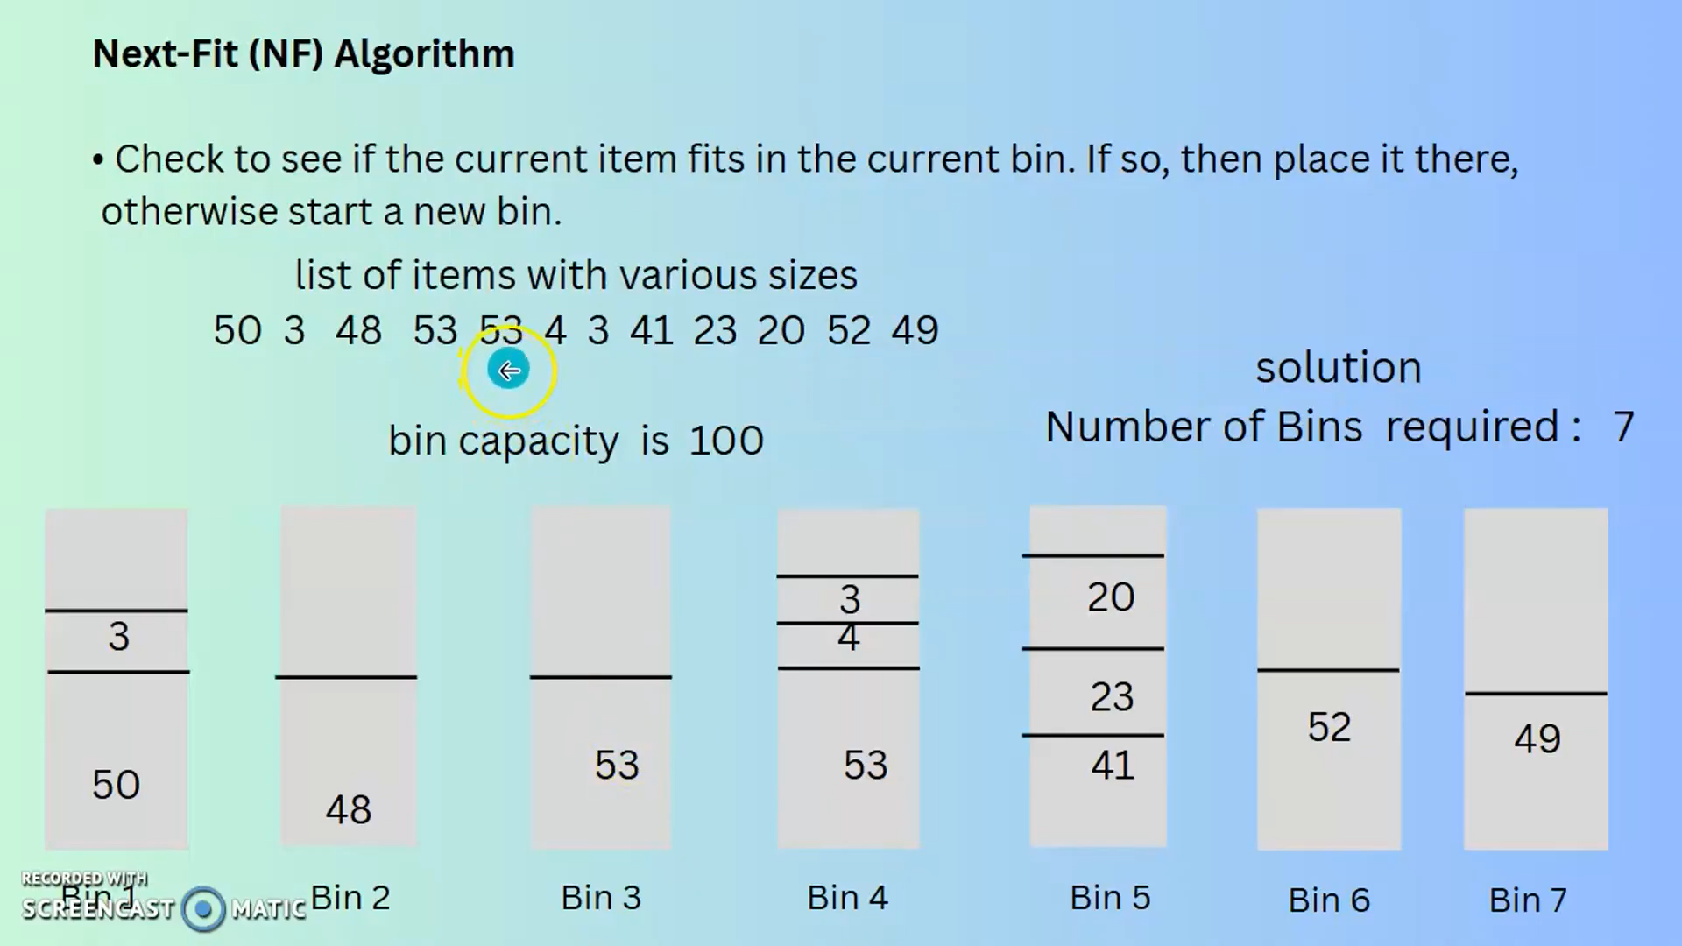

Slide 32
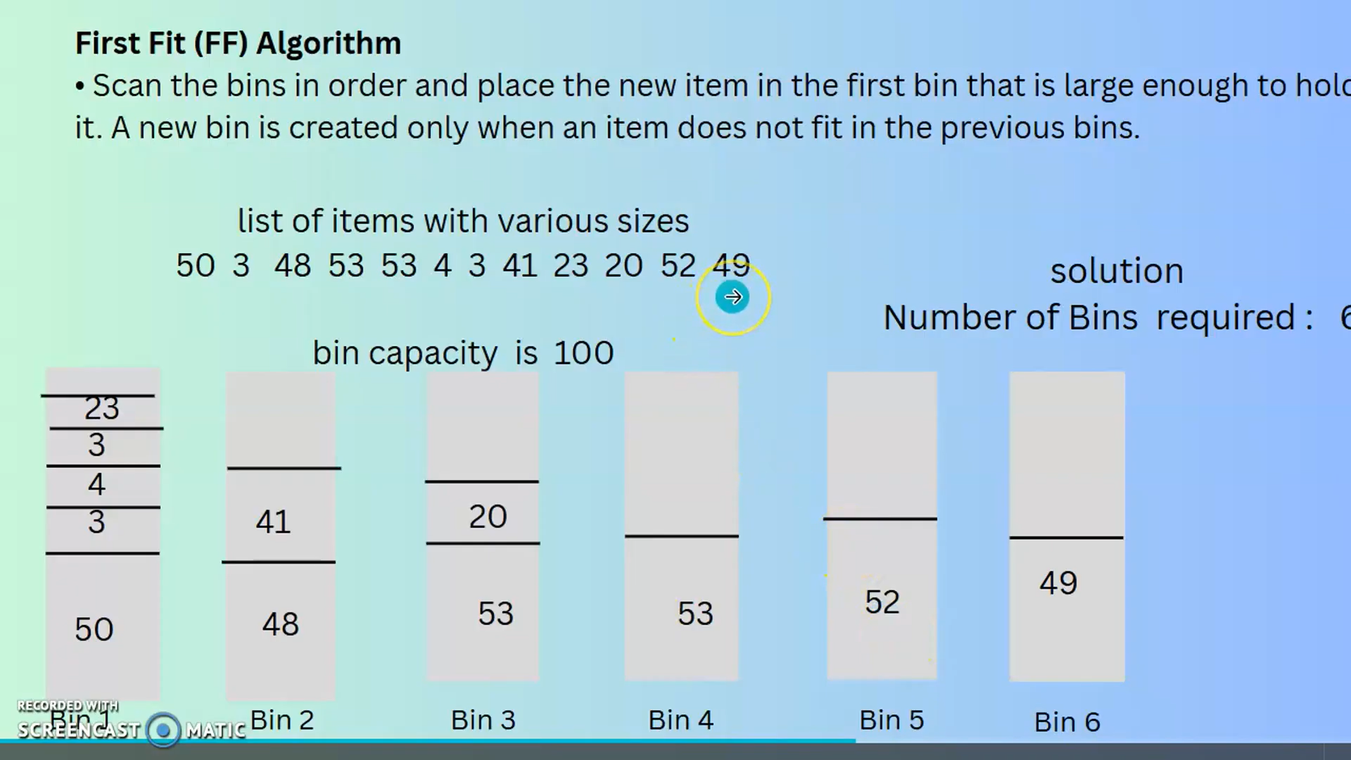

Slide 33
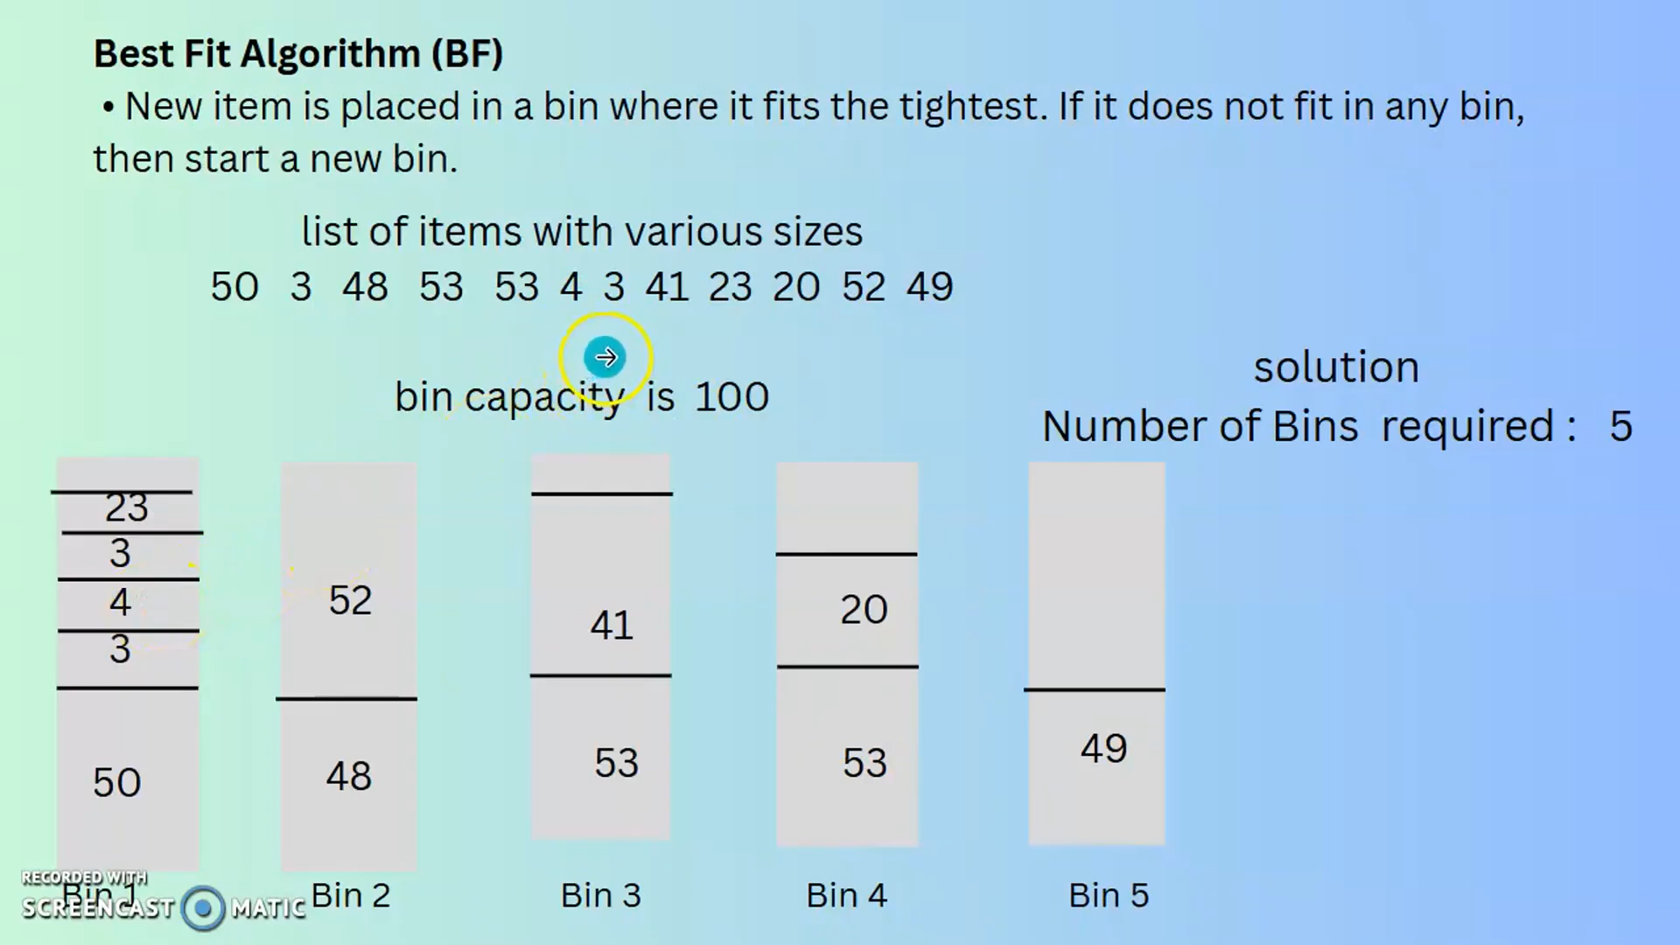

Slide 34
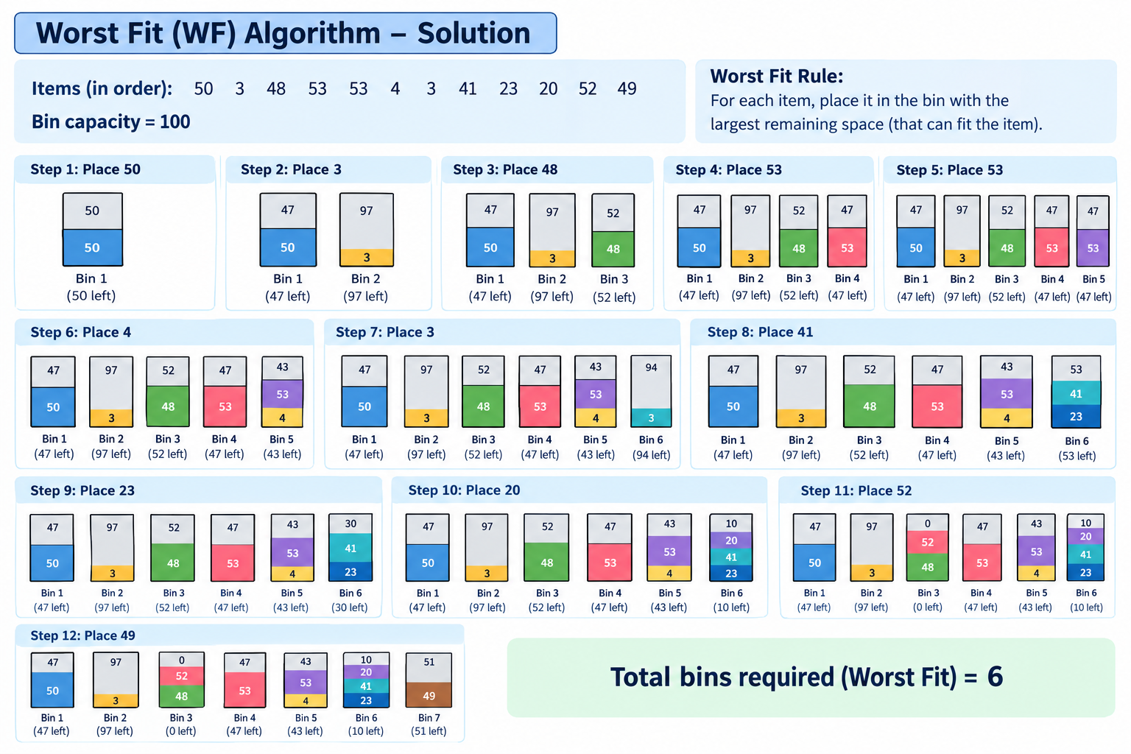

Slide 35
Bin Packing problem
Next Fit algorithm
The simplest approximate approach to the bin packing problem is the Next-Fit (NF) algorithm which is explained later in this article.
The first item is assigned to bin 1. Items 2,... ,n are then considered by increasing indices : each item is assigned to the current bin, if it fits; otherwise, it is assigned to a new bin, which becomes the current one.

Slide 36
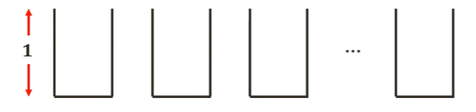
Bin Packing problem
Visual Representation
Let us consider the same example as used above and bins of size 1.
Assuming the sizes of the items be {0.5, 0.7, 0.5, 0.2, 0.4, 0.2, 0.5, 0.1, 0.6}.

Slide 37

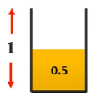
Bin Packing problem
Step 1 : The minimum number of bins required would be
Ceil ((Total Weight) / (Bin Capacity))= Ceil(3.7/1) = 4 bins.
Step 2: The Next fit solution (NF(I))for this instance I would be
Step 3: Considering 0.5 sized item first, we can place it in the first bin

Slide 38

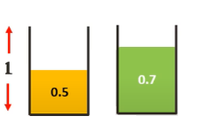

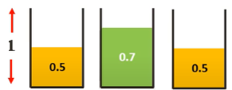

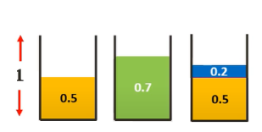
Bin Packing problem
Step 4: Moving on to the 0.7 sized item, we cannot place it in the first bin. Hence we place it in a new bin.
Step 5: Moving on to the 0.5 sized item, we cannot place it in the current bin. Hence we place it in a new bin.
Step 6: Moving on to the 0.2 sized item, we can place it in the current (third bin)

Slide 39

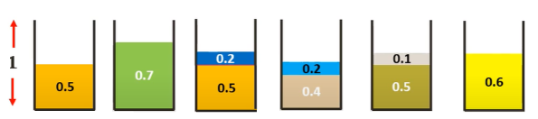
Bin Packing problem
Step 7: Similarly, placing all the other items following the Next-Fit algorithm we get,
Thus we need 6 bins as opposed to the 4 bins of the optimal solution. Thus we can see that this algorithm is not very efficient.

Slide 40
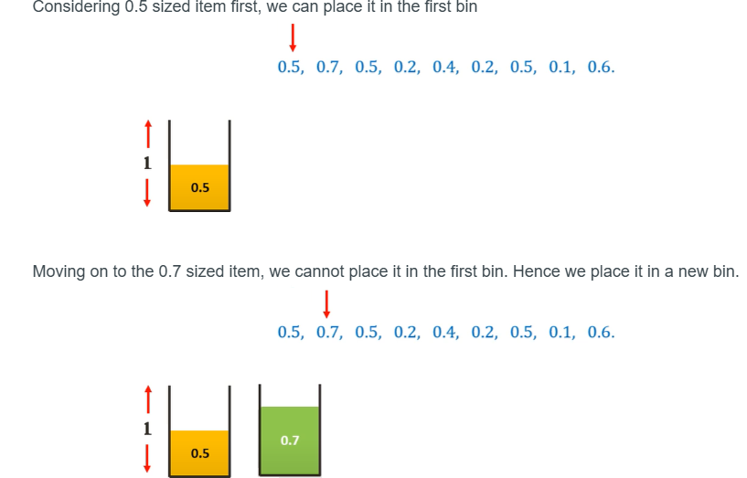
Bin Packing problem
2) First Fit algorithm
Step1
Step2

Slide 41
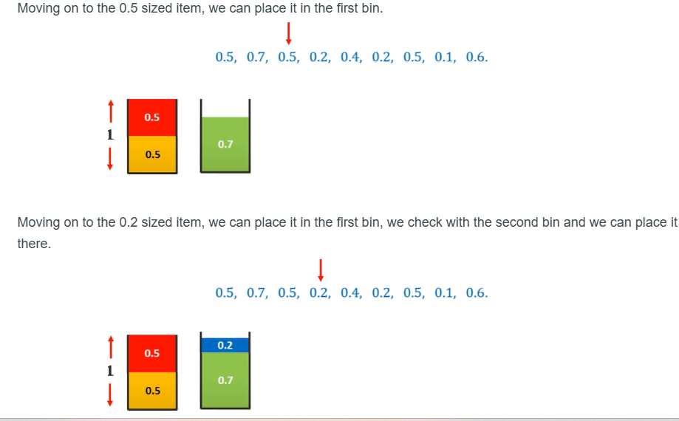
Bin Packing problem
Step 3
Step 4

Slide 42
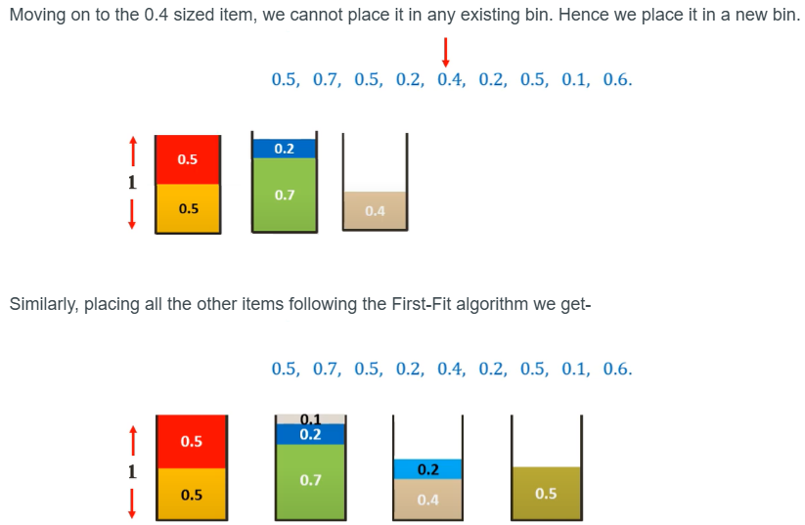
Bin Packing problem
Step 5
Step 6
Thus we need 5 bins as opposed to the 4 bins of the optimal solution but is much more efficient than Next-Fit algorithm.

Slide 43
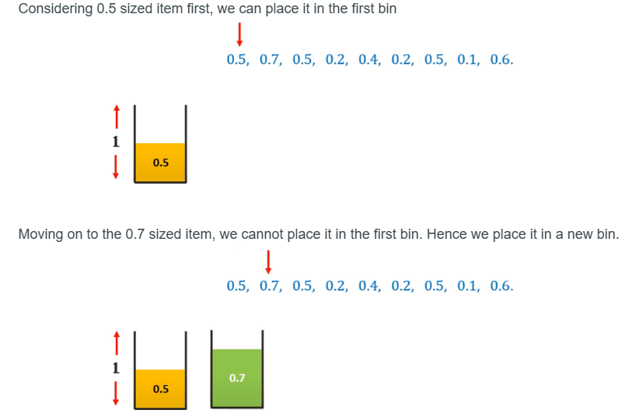
Bin Packing problem
3. Best Fit Algorithm
Step 1
Step 2

Slide 44
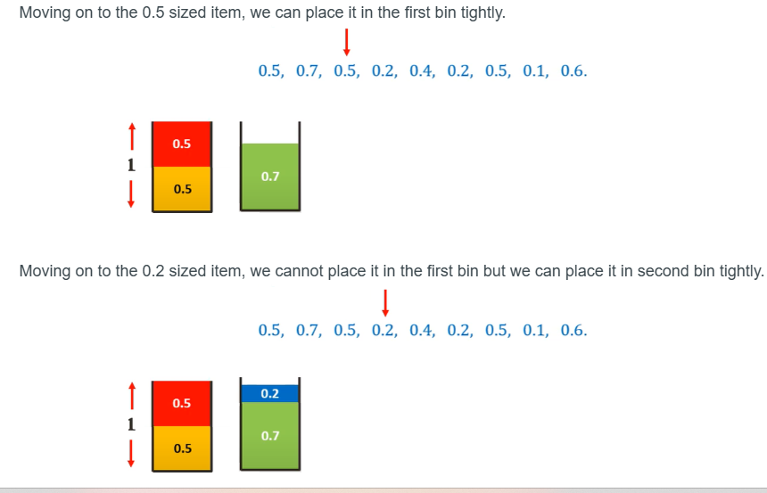
Bin Packing problem
Step 3
Step 4

Slide 45
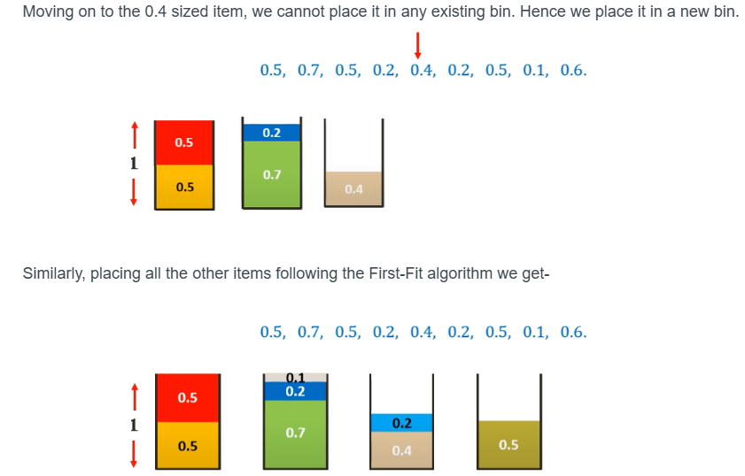
Bin Packing problem
Step 5
Step 6

Slide 46
Problem Reduction
What is Problem Reduction?
Problem reduction is an algorithm design technique that takes a complex problem and reduces it to a simpler one.
The simpler problem is then solved and the solution of the simpler problem is then transformed to the solution of the original problem.
Problem reduction is a powerful technique that can be used to simplify complex problems and make them easier to solve. It can also be used to reduce the time and space complexity of algorithms.

Slide 47
Problem Reduction
Example: Calculate the LCM (Least Common Multiple) of two numbers X and Y.
Approach 1:
To solve the problem one can iterate through the multiples of the bigger element (say X) until that is also a multiple of the other element. This can be written as follows:
Select the bigger element (say X here).
Iterate through the multiples of X:
  If this is also a multiple of Y, return this as the answer.
  Otherwise, continue the traversal.

Slide 48
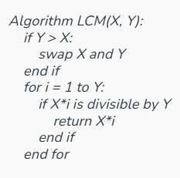
Problem Reduction
Example: Calculate the LCM (Least Common Multiple) of two numbers X and Y.
Approach 1:
To solve the problem one can iterate through the multiples of the bigger element (say X) until that is also a multiple of the other element. This can be written as follows:
Select the bigger element (say X here).
Iterate through the multiples of X:
  If this is also a multiple of Y,
  return this as the answer.
  Otherwise, continue the traversal.

Slide 49
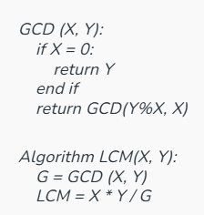
Problem Reduction
Approach 2 (Problem Reduction):
The above method required a linear amount of time and if the value of Y is very big it may not be a feasible solution.
This problem can be reduced to another problem which is to “calculate GCD of X and Y” and the solution of that can be transformed to get the answer to the given problem as shown below:
Calculate the GCD of X and Y using Euclid’s algorithm.
  Now we know that GCD * LCM = X*Y. So the LCM can be calculated as (X*Y/GCD).

Slide 50
Problem Reduction
Approach 2 (Problem Reduction):
The above method required a linear amount of time and if the value of Y is very big it may not be a feasible solution.
This problem can be reduced to another problem which is to “calculate GCD of X and Y” and the solution of that can be transformed to get the answer to the given problem as shown below:
Calculate the GCD of X and Y using Euclid’s algorithm.
  Now we know that GCD * LCM = X*Y. So the LCM can be calculated as (X*Y/GCD).

Slide 51
3 CNF Problem
3-CNF stands for 3-Conjunctive Normal Form, which is a special case of a Boolean formula written in Conjunctive Normal Form (CNF). A formula is in CNF if:
    It is a conjunction (AND) of one or more clauses.
    Each clause is a disjunction (OR) of literals.
    A literal is a Boolean variable or its negation.
In the 3-CNF problem:
    Each clause contains exactly three literals.
    The goal is to determine if there exists an assignment of truth values (true or false) to the variables such that the entire formula evaluates to true.

Slide 52
3 CNF Problem
Goal of 3-CNF
The goal of the 3-CNF problem is to determine whether a given Boolean formula in 3-Conjunctive Normal Form (3-CNF) is satisfiable.
This means finding whether there exists an assignment of truth values (True or False) to the variables in the formula such that the entire formula evaluates to True.
This is often called the 3-SAT (3-Satisfiability) problem.

Slide 53
3 CNF Problem
A Boolean formula is in 3-CNF if it is an AND of clauses, with each clause containing exactly three literals connected by OR.
Example: F=(x V y V z) ∧ (¬x V y V ¬z)
∧ means AND.
∨ means OR.
¬ means NOT.
Important: The 3-SAT problem, which asks whether a 3-CNF formula is satisfiable, is NP-complete.

Slide 54
Approximation algorithms
An approximation algorithm is a way of dealing with NP-completeness for an optimization problem. This technique does not guarantee the best solution.
The goal of the approximation algorithm is to come as close as possible to the optimal solution in polynomial time.
Such algorithms are called approximation algorithms or heuristic algorithms.
Some examples of the Approximation algorithm :
Here, Some examples of the Approximation Algorithm as follows.
    The Vertex Cover Problem
    The Set Covering Problem
    Travelling Salesman Problem
    The Subset Sum Problem

Slide 55
Approximation algorithms
An approximation algorithm is a way of dealing with NP-completeness for an optimization problem. This technique does not guarantee the best solution.
The goal of the approximation algorithm is to come as close as possible to the optimal solution in polynomial time.
Such algorithms are called approximation algorithms or heuristic algorithms.
Some examples of the Approximation algorithm :
Here, Some examples of the Approximation Algorithm as follows.
    The Vertex Cover Problem
    The Set Covering Problem
    Travelling Salesman Problem
    The Subset Sum Problem

Slide 56
Randomized Algorithms: Concept and Applications
Concept of Randomized Algorithms
An algorithm that uses random numbers to decide what to do next anywhere in its logic is called a Randomized Algorithm.
A randomized algorithm uses random numbers or random decisions during its execution.
Unlike deterministic algorithms, which always produce the same output for a given input, randomized algorithms may produce different outputs or have different execution paths for the same input.

Slide 57
Randomized Algorithms: Concept and Applications
Types of Randomized Algorithms
Las Vegas Algorithms:
  Always produce the correct result.
  Randomization only affects the runtime.
  Example: Randomized Quick Sort.
Monte Carlo Algorithms:
  May produce an incorrect result with a small probability.
  Randomization affects both the output and runtime.
  Example: Randomized primality testing.

Slide 58
Randomized Algorithms: Concept and Applications
Applications of Randomized Algorithms
    Primality testing
    Randomized quick sort
    Finding kth smallest number
1. Primality Testing
Problem: Determine if a given number n is a prime number.
Algorithm: The Miller-Rabin Primality Test is a popular randomized algorithm for primality testing

Slide 59
Randomized Algorithms: Concept and Applications
Miller-Rabin Primality Test:
Select a random integer a between 2 and n−2.
Perform modular exponentiation to test a mathematical property of n (related to Fermat's Little Theorem).
If n fails the test for any aaa, it is composite.
If n passes the test for all chosen a, it is probably prime.
Type: Monte Carlo algorithm (can incorrectly classify a composite number as prime with a small probability).
Application: Used in cryptography (e.g., RSA key generation).

Slide 60
Randomized Algorithms: Concept and Applications
2.Randomized Quick Sort
Problem: Sort an array of n elements.
Algorithm:
  Choose a random element as the pivot.
  Partition the array into two parts: elements less than the pivot and elements greater than the pivot.
  Recursively sort the two parts.
Randomization:
Randomly selecting the pivot ensures balanced partitions on average, reducing the chance of worst-case performance.

Slide 61
Randomized Algorithms: Concept and Applications
Time Complexity:
  Best/Average Case: O(n log n)
  Worst Case: O(n^2) (rare due to randomization)
Application: Efficient sorting in databases, systems, and libraries.
3. Finding the k-th Smallest Number
Problem: Find the k-th smallest element in an unsorted array of n elements.
Algorithm: Randomized Quick Select (a variation of Quick Sort).
Randomized Quick Select:
Randomly select a pivot.
Partition the array into elements less than and greater than the pivot

Slide 62
Randomized Algorithms: Concept and Applications
3) Compare the pivot’s position to kkk:
  If the pivot is the k-th smallest, return it.
  If k lies in the left partition, recursively find the k-th smallest in the left part.
  If k lies in the right partition, adjust k and recursively search the right part.
Time Complexity:
  Average Case: O(n)
  Worst Case: O(n^2) (rare due to randomization).
Application: Used in statistics (median finding), data analysis, and machine learning for feature selection.

Slide 63
Thank you!!

